Slide 1


YUCI
C Poorvika - 22PD10
Data Science Intern, Yubi

Slide 2
Academic Guide
Director
Dr.R Nadarajan
Department of Applied Mathematics and Computational Sciences
PSG College of Technology
Dr. Poomagal S Associate Professor
Department of Applied Mathematics and Computational Sciences
PSG College of Technology
Special thanks
Head of the Department
Dr.Shina Sheen
Department of Applied Mathematics and Computational Sciences
PSG College of Technology
Tutor
Ms. Lakshmi Kalpana Roy K Assistant Professor
Department of Applied Mathematics and Computational Sciences
PSG College of Technology
Programme Coordinator
Dr.Senthil Kumar M
Department of Applied Mathematics and Computational Sciences
PSG College of Technology
Industry Mentor
Mr. Nishanth Ronald Director - CAPL Data Science Department
Yubi Fintech Group

Slide 3


Overview
Introduction to the Organization
Solution
Timeline
Problem statement
Tools &
Technologies used
Q & A

Slide 4
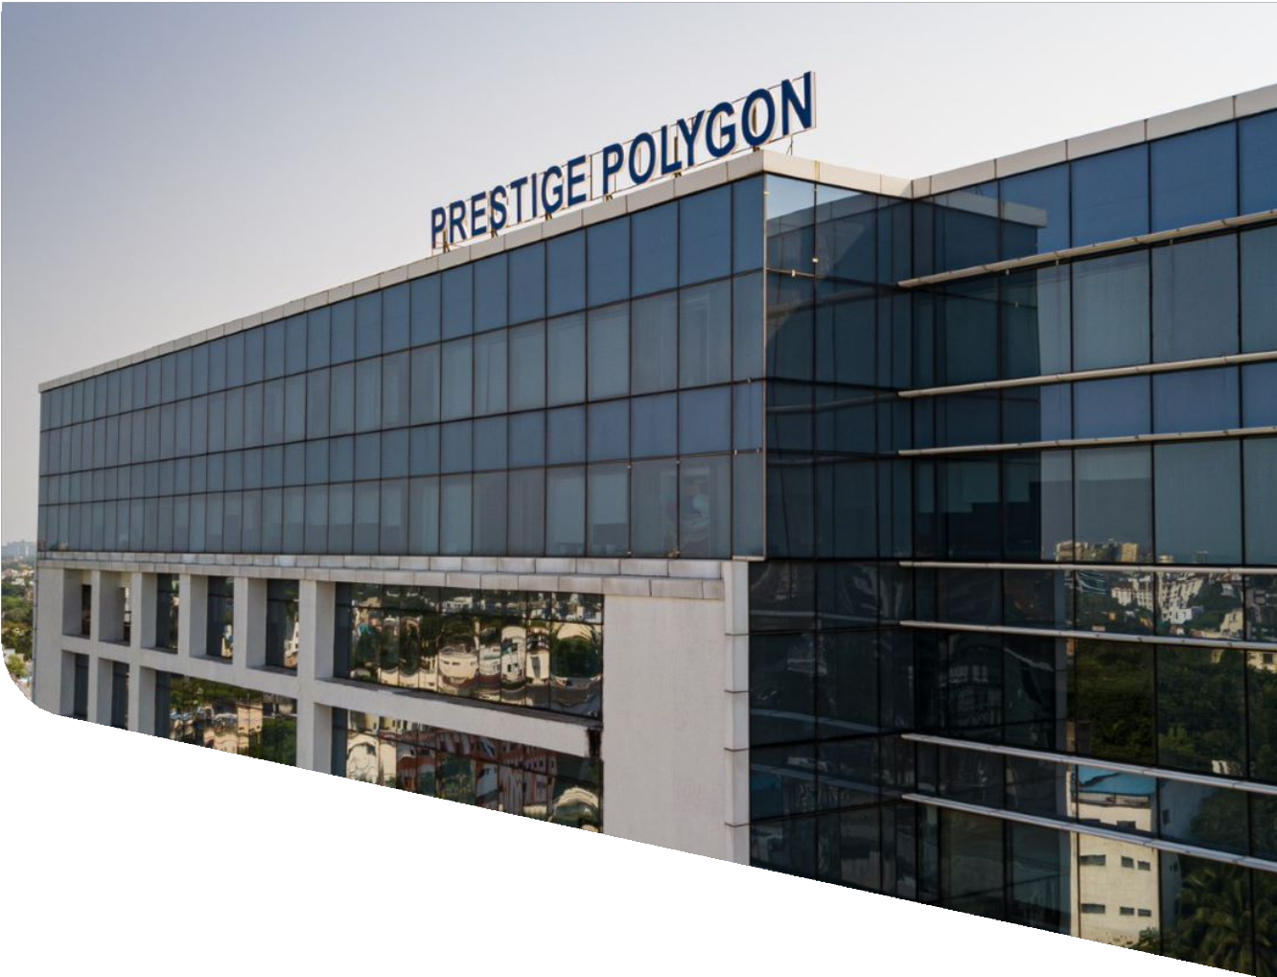

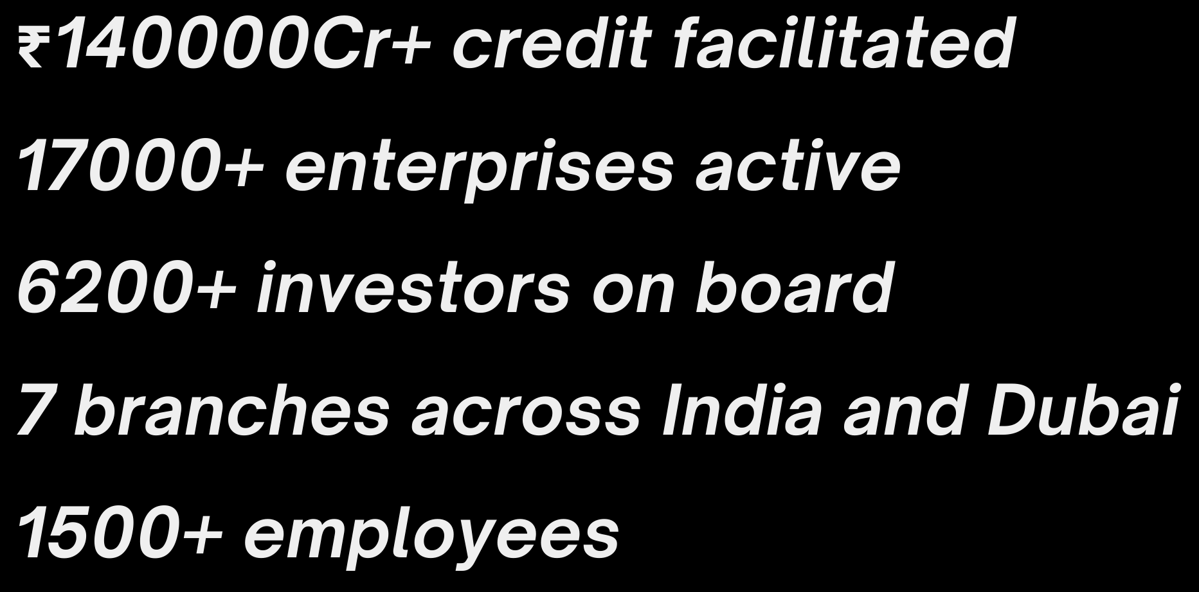
Yubi
About Yubi
Yubi (formerly CredAvenue) is a global fintech unicorn revolutionizing corporate debt markets by connecting borrowers, lenders, and investors on a unified digital marketplace. Founded in 2020, it powers the entire debt lifecycle—covering loans, co-lending, securitization, bonds, and supply chain financing—while serving 80% of India’s top banks and 150+ NBFCs. With AI-driven solutions like YuSight (credit assessment), YuCi (conversational intelligence), and YuAccess (document due diligence), backed by the Yubi Security Assurance (YSA) framework, Yubi ensures efficient, secure, and accessible debt financing.

Slide 5
Hardware Specifications Processor - Apple M1 Pro Installed Memory - 16GB
System Type - 64-bit Operating System, ARM64-based processor
Work environment
Software Specifications
macOS Sequoia 15.6.1

Slide 6
YUCI
YuCI being a part of the YuVerse products is a cutting-edge Conversational Intelligence (CI) tool that evaluates call quality with precision. Its advanced ASR module listens to voice interactions and seamlessly transcribes them into text mainly concentrating on Indian regional languages, significantly enhancing compliance monitoring efficiency and ensuring smoother, more compliant customer interactions.

Slide 7
Automatic Speech Recognition - ASR To converts spoken language (audio) into written text using various models (Benchmarking).
Voice of the Customer The sentiment analysis project evaluated public perception of the Bank and its competitors using data collected from platforms such as Reddit, Trustpilot and Google Play Store.
Financial Statement Analyser Developed an AI-powered ETL pipeline that automated extraction of financial data and transformed unstructured text into structured JSON formats using LLMs.
Problem Statements

Slide 8
Automatic Speech Recognition
Converting audio files and performing automatic speech recognition (ASR).
It is the technology that converts spoken language (audio) into written text.
1. Converts audio files (MP3 to WAV) and processes audio channels (stereo to mono) to prepare input data in the ideal format for ASR models, improving transcription accuracy and efficiency.
2. Resamples all audio to 16 kHz, the standard sample rate required by many ASR models, ensuring compatibility and better recognition performance.
3. Used the AI4Bharat Indic-Conformer 600M multilingual model, optimized for Indian languages, combined with advanced decoding methods like CTC and RNNT, resulting in accurate speech-to-text transcriptions in multiple languages.
4. Experimented with NVIDIA and other models such as FastConformer, Canary, and Whisper, demonstrating flexibility in choosing architectures based on accuracy or speed requirements.

Slide 9
Sentiment Analysis
Data extracted from multiple Social media platform is aggregated and transformed to know about the people’s view on the bank
Reviews
Text Extraction
Sentiment analysis
Data
Unstructured
Comments
Tweets
For Sentiment Analysis:
VADER
RoBERTa-Twitter model
RoBERTa-Base
TextBlob
Bert classification model

Slide 10
Financial Statement Analyzer
Designed to extract structured financial data (Balance Sheet, Profit & Loss, Trading accounts, and Notes) from raw financial documents using a Large Language Model (LLM). The extracted data is saved into a clean JSON file for further analysis.
Specialized in prompt engineering to ensure accurate, consistent outputs and robust handling of edge cases.
Conducted result validation and iterative prompt fine-tuning to optimize accuracy and reliability.
Key Components
1. LLM Setup:
Defines an LLM class to connect with a language model API (like GPT, Claude, Gemini, etc.).
Supports different available models (e.g., gpt-4.1-(US), bedrock-claude-3.5-(US), gemini-2.0-flash).
Handles sending prompts and receiving responses in text format.
2. Prompt Engineering
Builds a very detailed prompt that tells the LLM exactly how to extract financial data.
3. JSON Parsing
The script uses JsonOutputParser and regex helpers to ensure the LLM’s output is valid JSON.

Slide 11
Solution
For extracting key datapoints from a specific document, RAG based retrieval is used
Retrieval Query + prefilters
Similarity search
Vector DB
to^{p k}
Sections in the document relevant to the datapoint
context
LLM inferencing
+ JSON parser
Datapoints in JSON format

Slide 12
Solution
Extracted data from various documents is categorized into major sections such as Management, Business Operations, and Financials based on its content
The JSON structured data points for each doument, along with their respective sections, are stored in a common database, including file and company-level metadata
For sections with data from multiple files, SMEs define a priority order—e.g., audited financials are checked first for specific metrics, with fallback sources used if needed
LLMs generate section-wise commentaries using precise prompts, ensuring accuracy and relevance. Some rely on prioritized sources (e.g., audited financials for key metrics), while others take a holistic view, such as analyzing performance trends using both current and historical data

Slide 13








Tools & Technologies
Programming
Extraction
PDF Parsing libraries for unscanned pdfs - pdfplumber
VLMs and OCR tools for Scanned PDFs
JSON formatter
LLM

Slide 14

Timeline
Dec
Jan
Feb
MAR
Onboarding and KT sessions
Experimenting and
benchmarking different tools for extraction
Intern hackathon
Working on the main project completing the extraction pipelines
Integrating pipelines and standardising
Working on commentary generation

Slide 15

Timeline
June
July - Week 1
July - Week 2 & 3
July - Week 4 & Aug - Week 2
Onboarding and KT sessions
Experimenting and benchmarking different tools for extraction Discussing Ideologies and developing robust solutions
Working on the First Task Splitting into teams for information collecting, cleaning and analysis for a bigger client project
Intern Hackathon Team allocation and starting works on deliverables.

Slide 16
Q & A

Slide 17
THANK YOU

